Slide 1

UniLifeTracker
Time and finance manager for working students
Yanina Morales
X23437812
Notes:
"Hello everyone, thank you for joining my presentation.Today, I’ll introduce UniLifeTracker, a web application designed to help part-time students manage their finances, time, and well-being in a simple and motivating way."

Slide 2

UniLifeTracker Background of Project
Many university students face the challenge of balancing their academic life with work, which involves organising income, expenses and complex schedules. I identified the need for a centralised platform that helps keep a simple and visual record of finances and events, and as extra encourages personal motivation.
Notes:
"As a student myself, I realized it can be difficult to keep track of income, expenses, and daily routines while balancing university and work life.My goal was to create a friendly platform that not only helps manage money and time but also encourages self-improvement and organization."

Slide 3

UniLifeTracker
Aims / Problem & Solution / Customer
Problem: Working students often lack simple tools to manage their accounts and schedules, which complicates their organisation and causes stress.
Solution: UniLifeTracker is a web app that allows users to manage their income, expenses, and events, and receive motivational quotes, all with security and simplicity.
Target customer: University students, especially those who work part-time and want a practical tool to manage their daily lives.
Notes:
"The main problem is that working students often lack simple tools to manage their accounts and schedules, making it hard to stay organized and avoid stress. UniLifeTracker addresses this by offering an easy-to-use web application where users can manage their income, expenses, and events, and even receive motivational quotes—all in a secure and straightforward environment. The main target is university students, especially those working part-time who need a practical tool for everyday life."

Slide 4
UniLifeTracker
Theoretical Background / Technologies Used
Backend: Java + Spring Boot
Database: PostgreSQL
External APIs: EUR-CLP currency conversion (open.er-api.com)
Security: JWT for authentication and authorisation
ORM: Hibernate, Spring Data JPA
Testing: Unit tests and Postman
Layered architecture, separation of responsibilities and secure development best practices were applied.
Notes:
Theoretical Background – brief description of technologies used in project
Relevant literature
"UniLifeTracker's backend is built with Java and Spring Boot. For data storage, it uses PostgreSQL. I integrated an external API for currency conversion. Security is handled with JWT authentication and authorization. I also used Hibernate and Spring Data JPA for ORM, and the project is well tested using unit tests and Postman. Throughout, I applied best practices for layered architecture and secure development."

Slide 5
UniLifeTracker
Requirements
User registration and login with validations
Registration and consultation of income and expenses
Display of current balance
Personal events calendar
Consultation of motivational phrases
Integration with external API for exchange rate
Simple and secure user experience
Notes:
"The app allows users to register and log in, both with strong validations. They can add and view incomes and expenses, see their current balance, and manage their personal calendar. There’s also a section for motivational quotes, and the app can convert currencies using an external API. All of this is done with a focus on a simple and secure user experience."

Slide 6
UniLifeTracker
Design
3-layer architecture: REST controller, service (logic), repository (data)
Central security: JWT filter
Decoupled controllers for each main function
Efficient consumption of external APIs
Notes:
“The interface was designed with ease of use in mind. Here are some examples of the main pages: dashboard, income list, expenses, and calendar. Soft colours and a minimalist design were used to make it pleasant and non-distracting.”
“Some notable features include graph visualisation, data export to Excel, real-time balance updates, and small motivational messages to keep morale high during the semester.”

Slide 7
UniLifeTracker
Code & Testing
Main components:
Controllers: users, income, expenses, events, phrases, currencies
Services for business rules and validation
JwtAuthenticationFilter filter for protected endpoints
Tests performed:
Unit tests on services
Manual and Postman tests on registration flows, login, financial operations, and external API queries
Error handling verification (token, invalid data, API outages)
Notes:
Code & Testing
"The application uses a classic three-layer architecture: REST controllers for the endpoints, service classes for business logic, and repositories for data access. JWT-based security is centralized through a filter. Each main function—such as users, incomes, and events—has its own controller. The app is designed for efficient API consumption, and I've also included a data flow and security diagram to illustrate how everything fits together.“

Slide 8
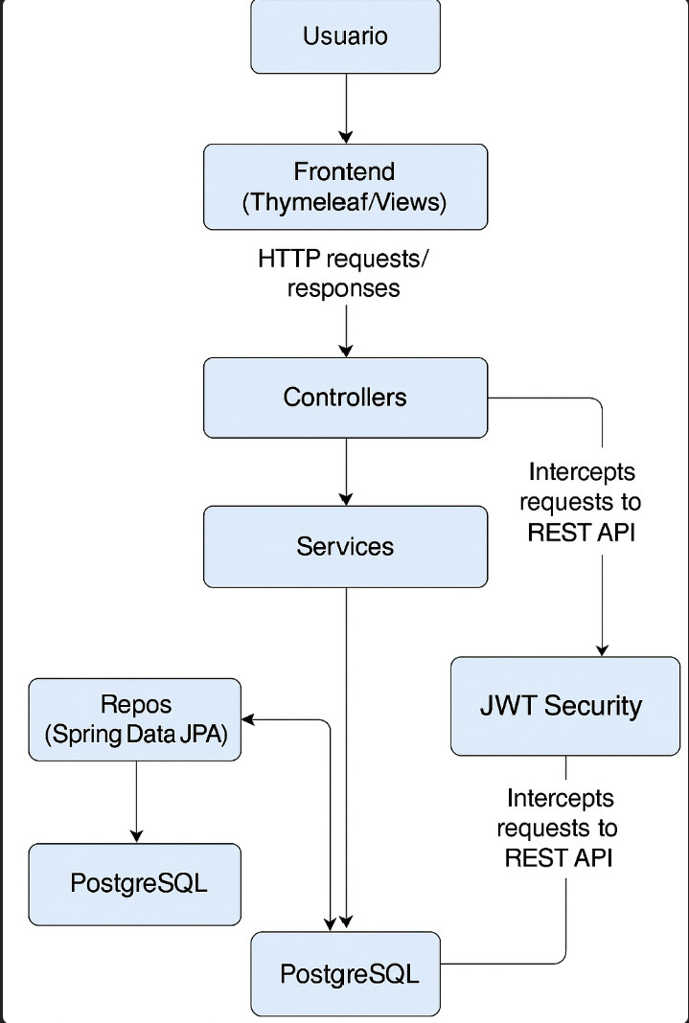
Notes:
"The code is organized into controllers, services, and repositories. Each main feature—users, incomes, expenses, events, motivational phrases, and currency exchange—has its own component.
The user interacts with the web application.
The frontend (HTML+Thymeleaf+Tailwind) processes the views and sends requests to the backend.
The backend (Spring Boot) manages business logic, authentication, calculations, and data access.
The backend communicates with the PostgreSQL database to store or query information about users, income, expenses, events, etc.
Responses flow in the opposite direction to display results to the user.

Slide 9
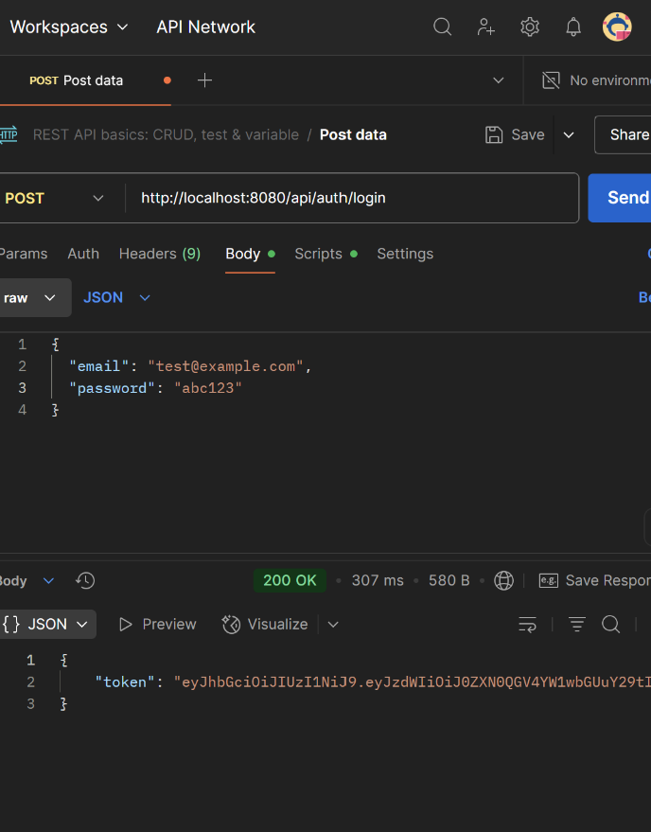
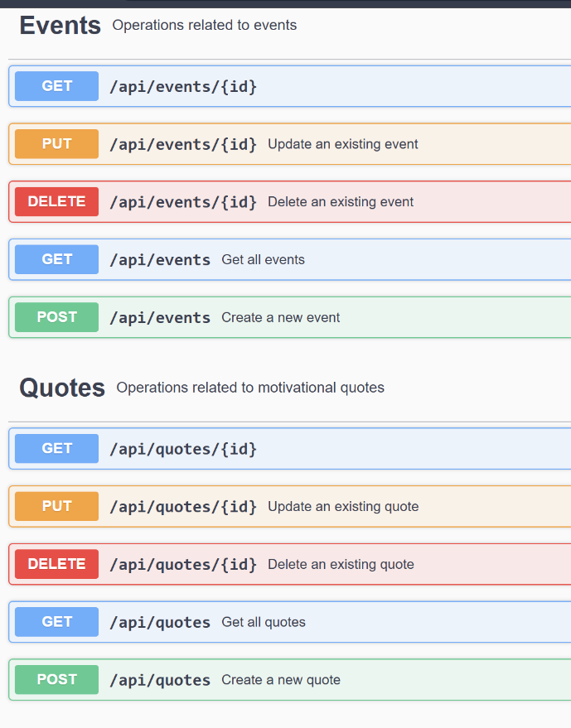
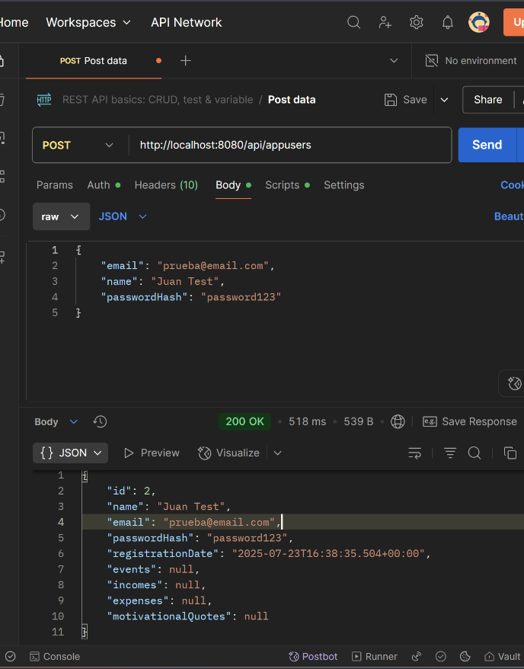
Postman and logs

Slide 10
UniLifeTracker
Evaluation
How was the system evaluated?
What are the results of the evaluation?
The system allows users to create accounts, log in, and navigate securely.
The functions for recording, consulting, and deleting income, expenses, and events work correctly.
The EUR-CLP exchange rate query was successfully implemented, handling possible external errors.
Error handling in endpoints protected with JWT was validated in different scenarios.
The system is robust, modular, and allows for future extensions.
Notes:
Security endpoints are protected by a JwtAuthenticationFilter. For testing, I wrote unit tests for the services and performed both manual and Postman tests for the main user flows, including registration, login, financial operations, and external API calls. Error handling is robust, covering invalid data and API outages."

Slide 11
Advantages & Limitations
Advantages:
Modularity and clear separation of responsibilities
Robust security with JWT
Ease of expansion and customisation for other countries or currencies
Limitations:
Depends on the availability of free APIs for certain functionalities
Basic graphical interface (or endpoints only)
Notes:
"Some key advantages of UniLifeTracker are its modularity and clear separation of responsibilities, strong security with JWT, and its flexibility to be expanded or adapted to other countries and currencies. On the other hand, the app currently depends on the availability of free APIs for some features, and the user interface is basic—mostly focusing on functionality for now."

Slide 12

Demo

Slide 13
Future upcomings
Mobile app implementation
Add personalised recommendations
other currencies
Introduce notifications
Search by filters
Investment advices section
Forum with other users
AI assistance to personalized schedule
Notes:
"Looking forward, I plan to develop a mobile version of UniLifeTracker, add more personalized recommendations, support additional currencies, and introduce notifications. Other ideas include adding filters for searches, a section for investment advice, a forum for users, and even AI-based assistance to help students optimize their schedules."

Slide 14
Q&A
Thank you!
Any questions?

